Slide 1
Supporting your child at home

Slide 2
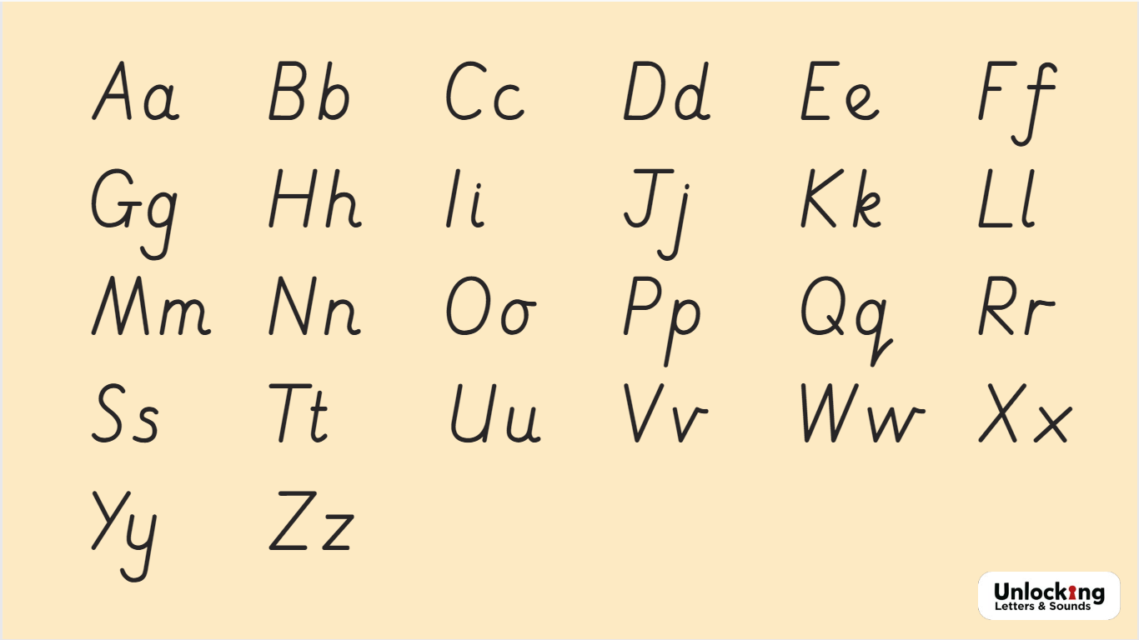
Phonics
Pronunciation of sounds

Slide 3
What you can do:
Hear them read regularly
Read to them regularly
Look out for phonic sounds or digraphs in everyday life – road signs, street names, books, newspapers etc.
Playing I Spy
Go on a sound or digraph hunt. Eg. On a walk, how many things can they find that begin with ‘ch’?
Let them experiment with writing sounds or words. Eg. letters, postcards, chalk writing on the pavement, painting

Slide 4
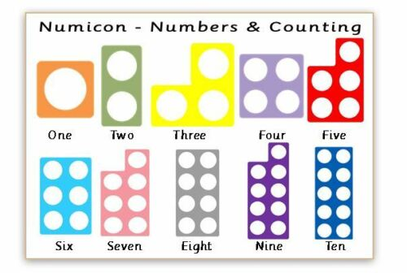
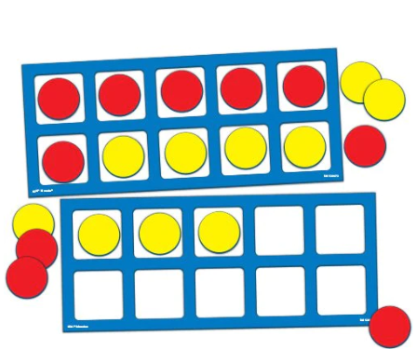
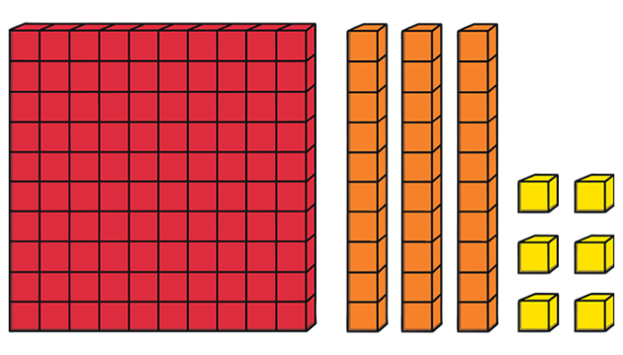
Maths
We use lots of equipment to support learning and some may not be familiar to you.
Numicon Base 10 Tens Frames

Slide 5
Maths
There is a huge focus on place value and understanding of number.
The children need to be able to separate numbers into tens and ones.
46
4 tens and 6 ones

Slide 6
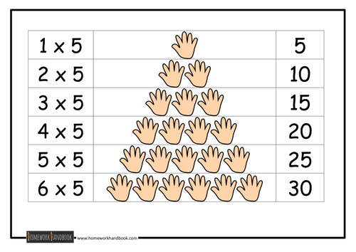
Maths
We also spend a lot of time counting in 2s, 5s and 10s.
This then links to our times tables and we work on the 2, 5 & 10 times tables.

Slide 7
What we do in school for reading
Each day
  The children have dedicated reading time for 15 mins everyday so they can independently read their decodeable book.
  Dedicated story time with the teacher where the children are exposed to carefully selected books that are simply to be listened to and enjoyed.
  Each week
    The teacher or teaching assistant will hear your child read aloud and swap books when needed. We aim for once a week but can’t always guarantee it. However, if they are not heard, we will check the reading record and if they have read at home, we will change the books.
    Whole class reading lessons focusing on reading skills and comprehension

Slide 8
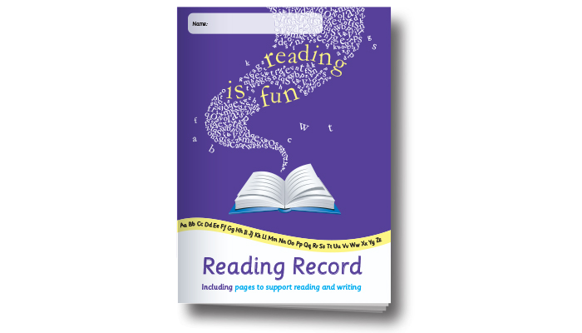
Reading records
Your child will have a reading record book in their
bookbag.
These are to be written in mainly by the teacher and parents but as the year progresses, your child may wish to write in it too.
When you hear your child read, please write this in the book with the date and a signature so we can celebrate their reading success with them.
If they read with a grandparent or other adult, they are welcome to write in the book too!

Slide 9

What books will your child bring home?
A decodable book
A Bug Club or other scheme book which ONLY contain sounds and tricky words that your child has been taught in school to enable them to experience success.

Slide 10
What books will your child bring home?
A truly decodable book should be 95% accessible to your child in order to help them experience success. This can sometimes feel like the book is ‘too easy’ for your child but it is a vital step in the journey towards reading for pleasure.
A book that is less accessible can quickly become demotivating for the child so we wish to avoid this and nurture lifelong readers!

Slide 11

What books will your child bring home?
A sharing book
A book from our class library that should be enjoyed together. These books are not fully decodable so while your child may like to identify some words, it will usually be read aloud by you.

Slide 12
The importance of repetition
Our advice, based on our recent training, is that the decodable books should be read four times across the week that you have it.

Slide 13

The importance of repetition
The first time your child reads it, they will be focusing on decoding.
It is the first time they will have seen these words so they will be sounding out and blending aloud or in their head.

Slide 14
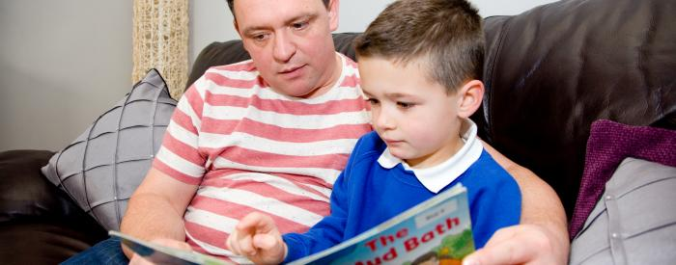
The importance of repetition
The second time your child reads it, they will be focusing on fluency.
Having seen it once, they can focus less on decoding and increase their speed and fluency.

Slide 15
The importance of repetition
The third time your child reads it, they will be focusing on comprehension.
Now they are familiar with the story, they can make predictions or inferences about the story in fiction. Equally they can comment on layout and information in non-fiction. Maybe you could ask some questions?

Slide 16

The importance of repetition
The final time your child reads it, they will be focusing on prosody/storyteller’s voice.
They know the book very well now and can
focus on expression. Could they read it to a
younger sibling or a teddy?

Slide 17
The importance of repetition
Decoding
Fluency
Comprehension
Prosody/storyteller’s voice

Slide 18

Bug Club
Your child will have access to ebooks as well through Bug Club. Reading each book more than once will also be beneficial. (See ‘My Library’)

Slide 19
If your child is reading chapter books:
The approach in this presentation is aimed at those children first learning to read and reading bug club decodeabe books exclusively.
If they have moved beyond this point onto short chapter books, we would not advise reading the longer book four times over a week.

Slide 20
If your child is reading chapter books:
The ideas in this approach are still valid however.
Once they are no longer focusing on decoding, it is still vital to practise fluency, comprehension and the storyteller’s voice when hearing your child read aloud.

Slide 21
Reading to your child
There are huge benefits to reading aloud to your child including the bonding experience, the modelling of the storyteller’s voice, listening practice and many more.
On those days when your child is too exhausted to read to you, enjoy the enormous value of reading to them instead.

