Slide 1
Remote Education at Northleaze

Slide 2
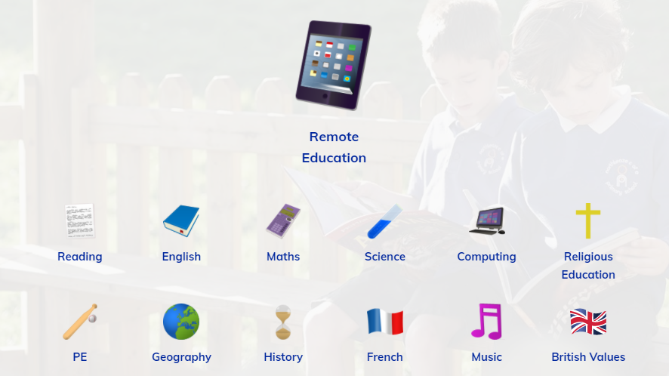
Will my child be taught broadly the same curriculum as they would if they were in school?
Yes. The curriculum at home will be very similar to the one that would have been taught at school had we not entered this lockdown period.
The pupils who are learning at home and those who are accessing the ‘Critical Worker’ provision in school will be taught the same curriculum.
Teaching assistants and learning support assistants will support children learning onsite, with class teachers working mainly from home. Children physically at school will access all ‘live’ teaching sessions led by the class teacher using MS Teams.
Information about the curriculum for remote education, along with example timetables and guidance for parents, can be found on the curriculum page of our website.

Slide 3
How long can I expect work set by the school to take my child each day?
Pupils in KS1 will have access to at least three hours of learning each day, with KS2 having access to four.
‘Live’ teaching sessions will vary in length (depending on the curriculum area and the year group) from 15 minutes to half an hour.
English lessons will mainly use the DfE approved ‘Oak Academy’ teaching videos.
Maths lessons will use the resources, worksheets and pre-recorded videos from ‘White Rose’.
Live daily sessions for Early Years pupils
  Registration
  Phonics (both ‘live’ and pre-recorded)
  Maths starter or input
  1:1 or small group reading
  Storytime
Live daily sessions Years 1-6
  Registration
  Maths starter and explanation of activity
  English starter and explanation of activity
  Wider curriculum subjects e.g. art, science, history
  Storytime

Slide 4


How will my child access any online remote education you are providing?
We use Microsoft Teams as our online learning platform. The following will be accessed, or carried out, through this platform:
  ‘Live’ lessons
  Daily timetables
  Worksheets and resources for lessons
  Assignment submission
  Marking and feedback from teachers
  Communication between pupils, parents and teachers

Slide 5
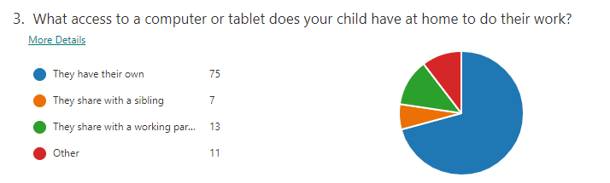
If my child does not have digital or online access at home, how will you support them to access remote education?
We have a number of laptops that can be donated to pupils during this time, with support given with their set up where required. Many of these have already been distributed to families.
A recent parent survey revealed that 12 pupils are sharing a device with a working parent. As a result, we have applied to the Trust for a further donation of laptops to support these families.
Please contact the school office if your child does not have access to an appropriate device.

Slide 6

How will my child be taught remotely?
Children have several ‘live’ teaching sessions each day.
English lessons (and some other curriculum subjects) will be delivered using the ‘Oak Academy’ teaching videos, often following an input from the class teacher.
Maths worksheets from the White Rose scheme will enable your child to work independently following their ‘live’ input.
Reception and Year 1 have daily ‘live’ or pre-recorded phonics lessons.
Following feedback from the recent parent survey, teachers will also plan some creative lessons which require less screen time.
All pupils will also have small group pastoral and/or guided reading sessions.
Pupils with SEND will receive 1:1 sessions, with either their class teacher or a teaching assistant, to work on their specific targets.

Slide 7
What are your expectations for my child’s engagement and the support that we as parents and carers should provide at home?
Ensure that your child joins as many of the Teams meetings as possible.
Regularly check in with your child to see if they are completing the work set by the teachers.
Establish a good routine early on and try to stick as closely to the class daily timetable as possible.
Give your child plenty of breaks and encourage them to go outside for these breaks where space, weather and supervision allow.
Contact your child’s class teacher, using the year group email account, if they are finding the work too challenging.
Help your child to submit their work (when required) via Teams and to correct their work following the feedback from their teacher.
Visit the remote education page of our website to view a presentation for parents regarding remote learning.

Slide 8
How will you check whether my child is engaging with their work and how will I be informed if there are concerns?
Teachers will use the participant list within the Teams meeting each morning to track attendance.
The Senior Leadership and Admin Teams will monitor pupils’ attendance and contact parents if a child has missed two or more sessions without explanation. A record of this contact and any action taken is maintained by the Admin Team and stored on our secure network.
Teachers will set two formal ‘assignments’ each week. Pupils will be required to submit their work via Teams so that teachers can mark it and provide detailed feedback.
If teachers have concerns about a pupil’s work or their wellbeing, they will contact parents by phone or email and possibly book a meeting on Teams to talk through the issues.

Slide 9
How will you assess my child’s work and progress?
Children will be required to submit two pieces of work each week.
Teachers will make it clear which pieces need to be submitted by setting ‘Assignments’ on Teams.
Teachers will respond to work with detailed feedback, giving praise and suggesting areas for development or ‘next steps’.
At the end of each maths unit, teachers will ask pupils to complete an assessment independently. These assessments will be submitted as an ‘assignment’ on Teams and will enable teachers to assess pupils’ progress.
Teachers will use these assessments to plan any small group ‘catch-up’ or ‘pre-teaching’ sessions for the following week(s).
An example of assignment feedback:

Slide 10
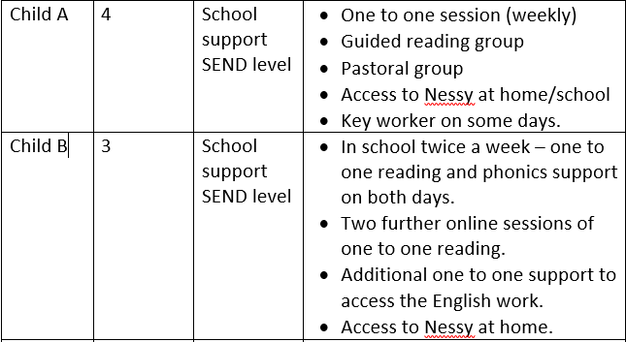
How will you work with me to help my child who needs additional support from adults at home to access remote education?
The SLT will lead regular Teams meetings for parents giving advice, support and top tips for remote education.
Children with SEND will receive 1:1 sessions to work on their targets and teachers will hold individual meetings with families where appropriate.
On the SEND page of our school website and in the newsletter we will share links to useful websites and helpful information for supporting children with additional needs.
An extract from the overview of remote or onsite support for pupils with SEND

