Slide 1
Remote Learning at Northleaze
January – February 2021

Slide 2
Overview
Thank you!
Feedback through your surveys last term (Y5 and IT)
Recognition of differing circumstances for each family - devices
Combination of ‘live' sessions and independent learning opportunities
Recorded to allow access through the day
Expectation of structured learning each day
1:1 or group sessions for pupils with additional needs to be added
Work in progress!
Please pop questions in the chat as we go along.

Slide 3
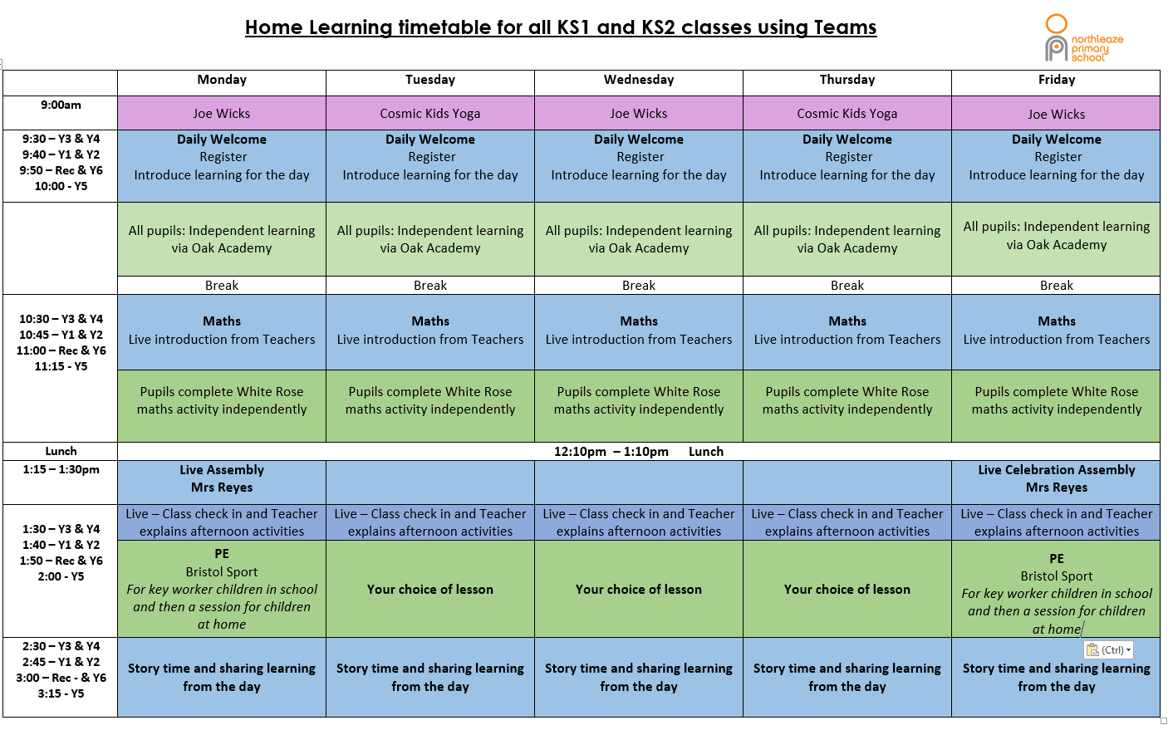
Timetable

Slide 4
Using MS Teams
To safeguard you all, children must:
  Be ready, be safe and be respectful when learning at home, just as they would be at school
  Sit against a neutral background where possible
  Wear suitable clothing –e.g. no pyjamas
  Be located in a communal area of the house. Where parents feel that they are best located in a room on their own, the door should remain open, with an adult within earshot of the session
  Mute until asked to unmute by the member of staff running the session
  Turn cameras/screen sharing off at their teacher’s discretion
  Not record, screenshot or otherwise the session
  Pass on any concerns they have about any element of the session to their parents/carers
‘Chat’ function! Teachers have set this so that children are not able to start their own chat

Slide 5
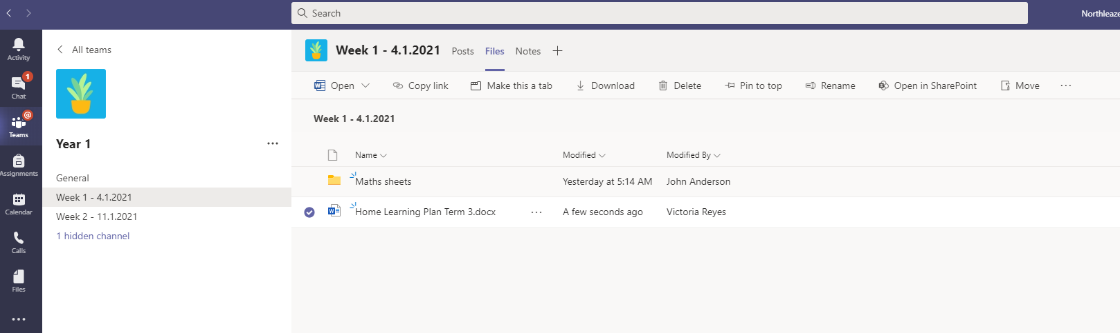
Using MS Teams
Teachers have set up ‘channels’ in the class page for each week
Within these channels will be the files containing any worksheets or activities for the day/week
Links to Oak Academy are in the ‘home learning’ table – see below for example:

Slide 6
Attendance and keeping in touch
Morning ‘check in’/registration
We will contact you if we don’t see your child for a couple of days – offer help
Continuing quality learning as much as possible
Year group email still best way of contacting class teacher (8.30am – 5.30pm)
Children can use the chat function (started by teachers) to ask any questions about a piece of work
School email will always be monitored school@northleazeprimary.co.uk

Slide 7
Top tips for working with your child!
Try and stick to a routine where your lives allow
Quiet (ish) space for them to work
Have equipment ready
Break tasks or instructions into small steps
Get children to repeat these back to you
Regular movement breaks
Short tasks
Bribery!
Use us!

Slide 8
Review
Feedback from you – quick survey at the end of this week
Need to consider the amount of work each day and whether this is appropriate
Mental health of everyone

