Slide 1
Let’s Get
Reading
Parent workshop
Thursday 11th January 2018

Slide 2


Slide 3
Aims
To help you understand how children learn to read and the skills they need.
To give you strategies when helping your child at home.
To underline the importance of children reading aloud to adults until they leave primary school (and after...)
To introduce the new materials we are sending home to help you support your children in their learning.

Slide 4
So why is Reading so important?
It helps children learn about the world
in which they live.
Good writing starts with good reading.
It is a key skill needed to progress in all other subjects.
Children develop a love of reading.

Slide 5
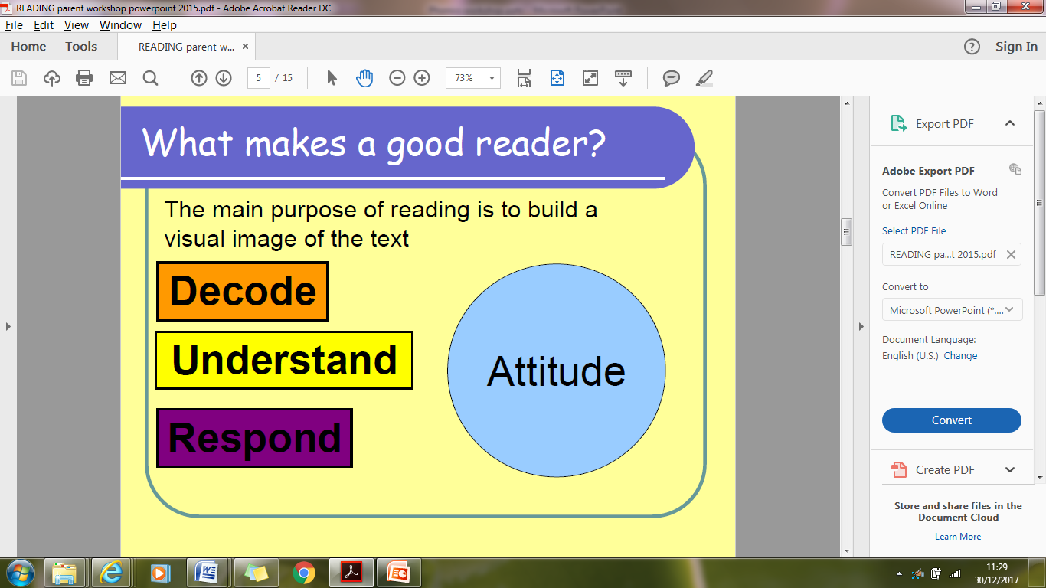
WHAT MAKES A GOOD READER?

Slide 6
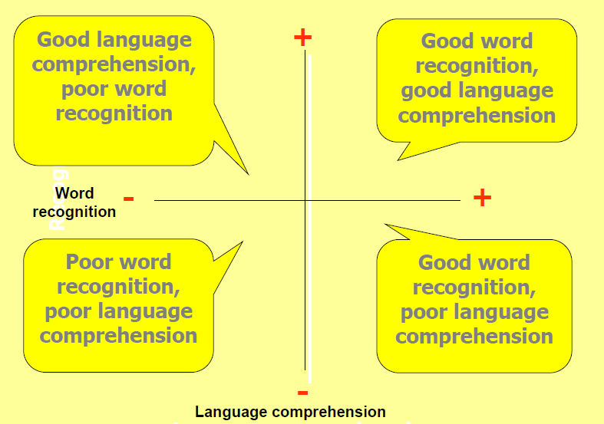
Children’s reading abilities can fall into one of four areas

Slide 7
How can you ENCOURAGE your child?
Encourage your child to read from a wide range of sources.
There is much to learn and enjoy from reading picture books, short stories, poetry, comics, magazines, instruction manuals and so on.
Provide a positive role model.
Chat about what you are reading in books, newspapers and magazines, or
viewing on screens. For older children have a ‘reading time’ at home where you turn off the TV and everyone reads for 20 minutes – including you!
Read with your child every day (or at least most days...)
The more you can read and share books with your children, the more opportunity they have to become better readers.
Listen to your child read.
All children like to receive positive feedback and listening to your child read is a great opportunity to congratulate him or her on what has been achieved.

Slide 8
WHICH IS BEST?
Should I read to my child or listen to them read to me?
BOTH!
Whilst some older children prefer to read to themselves, they can be lacking comprehension or missing opportunities to extend their vocabulary.

Slide 9
WHAT TO DO IF YOUR CHILD REFUSES TO READ
You may hear comments such as:
◗ Do I have to? I’m too tired. But I’m playing with...
It’s at this point that you may like to use one of the following strategies—because some reading practice is better than no reading practice!
◗ Use a timer (kitchen, sport) so your child understands that the reading practice will be for a short amount of time.
◗ Read the book aloud to your child but have your child read words that you know he or she can already read.
◗ Read something the child enjoys – a football magazine or even the TV guide!
◗ Read half the book each.
◗ Promise a treat at the end.

Slide 10
HOW YOU CAN SUPPORT READING COMPREHENSION AT HOME
KS1 COMPREHENSION
Give children ‘Find It’ questions and ‘Prove It’ questions.
‘Find It’ questions are literal questions – what colour was the ball?
‘Prove It’ involves inference and deduction – why was the boy sad?
“Katie took a drink out of her bag. The apple juice was cool and refreshing. “ Q: What was Katie’s drink?
• Teach idioms (i.e. You need to pull your socks up!)
• Always ask children to refer back to the text in their answer.
How do you know?

Slide 11
HOW YOU CAN SUPPORT READING COMPREHENSION AT HOME
KS2 COMPREHENSION
Find it and Prove it questions - Where/when does the story take place?
Vocabulary questions – What does this word/phrase tell you about the character’s mood?
Inference questions – “The boy skipped down the street.” How is the boy feeling?
Author questions – What effect has the author made by describing the trees as ‘looming over her like mysterious figures’?
Commentator questions - What is similar/different between these two characters?

Slide 12
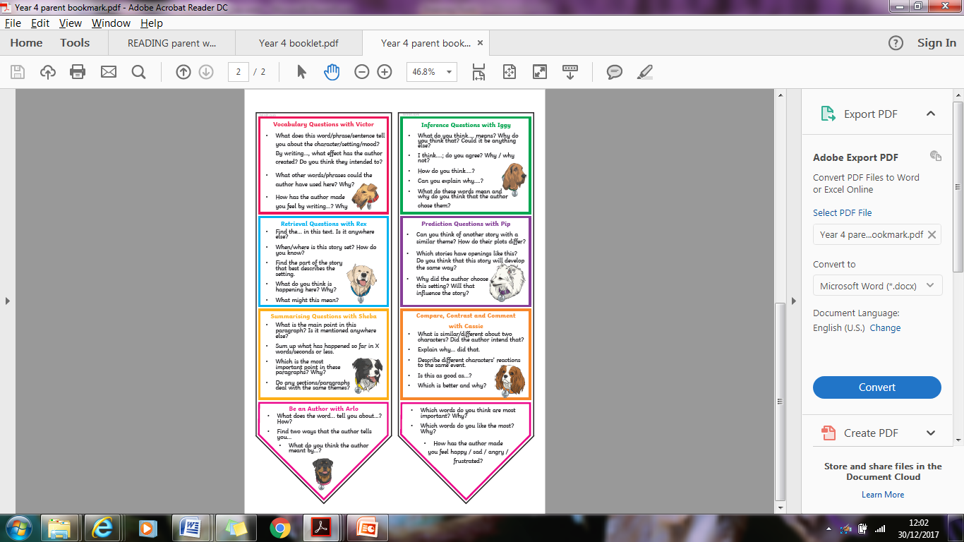
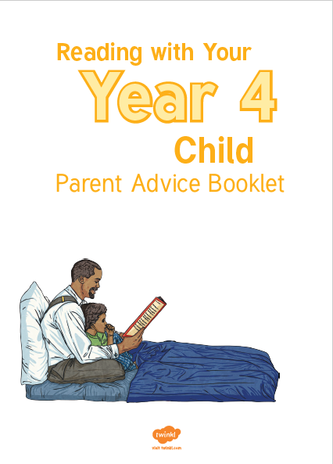
MATERIALS TO USE AT HOME

